Slide 1








keJoule
Joule
ke
Electric-Vehicle
Charge-Time
Optimization
THE CHALLENGE:
Companies need a way to manage the charging schedules of their employees’ vehicles.

Slide 2

The Team
Pinny Silver: CS
Avraham Meyers: CS
Elan Leonard: Business

Slide 3

Obstacles
New Technologies
Optimization
Ease of Use
Logistics

Slide 4



Solutions
Dynamic Schedule
Condensing Data Set
WPF
Email Integration

Slide 5
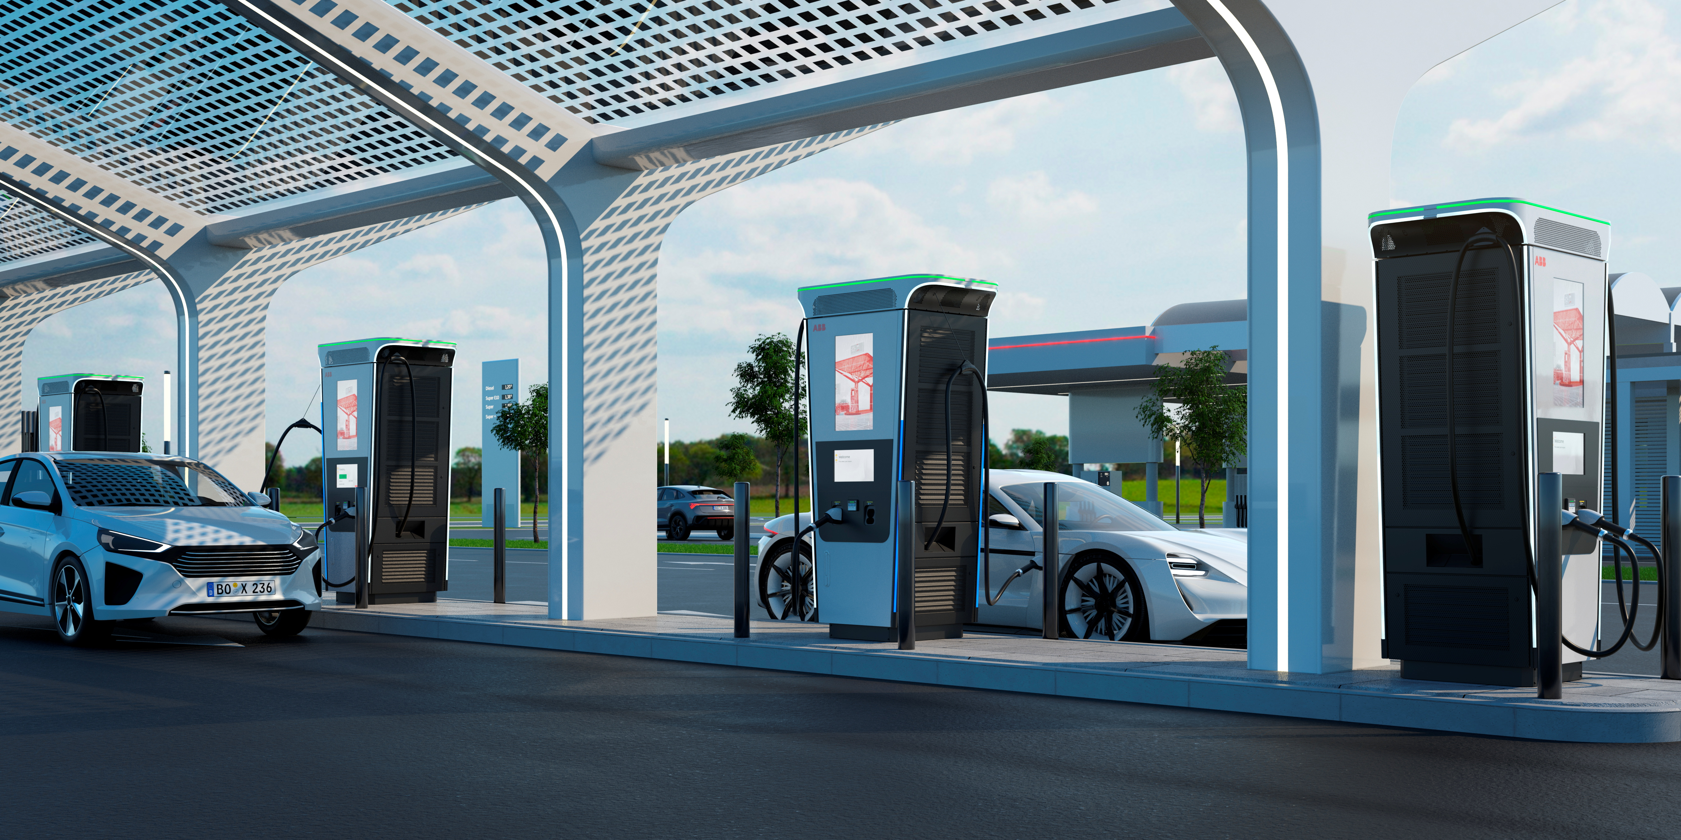
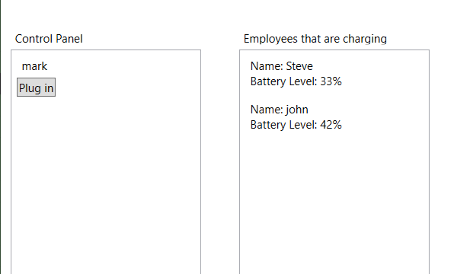
Presenting: SkeJoule
https://github.com/PSilver22/Hackathon2021

Slide 6


Business Opportunities
Many Reasons for Use:
Saves time and money
Good for Optics
Government Support
Encourages Employees to switch to electrical, good for optics
Saves money, making better use of fewer stations
Tax exemptions and credits for support of alternative fuel sources

Slide 7
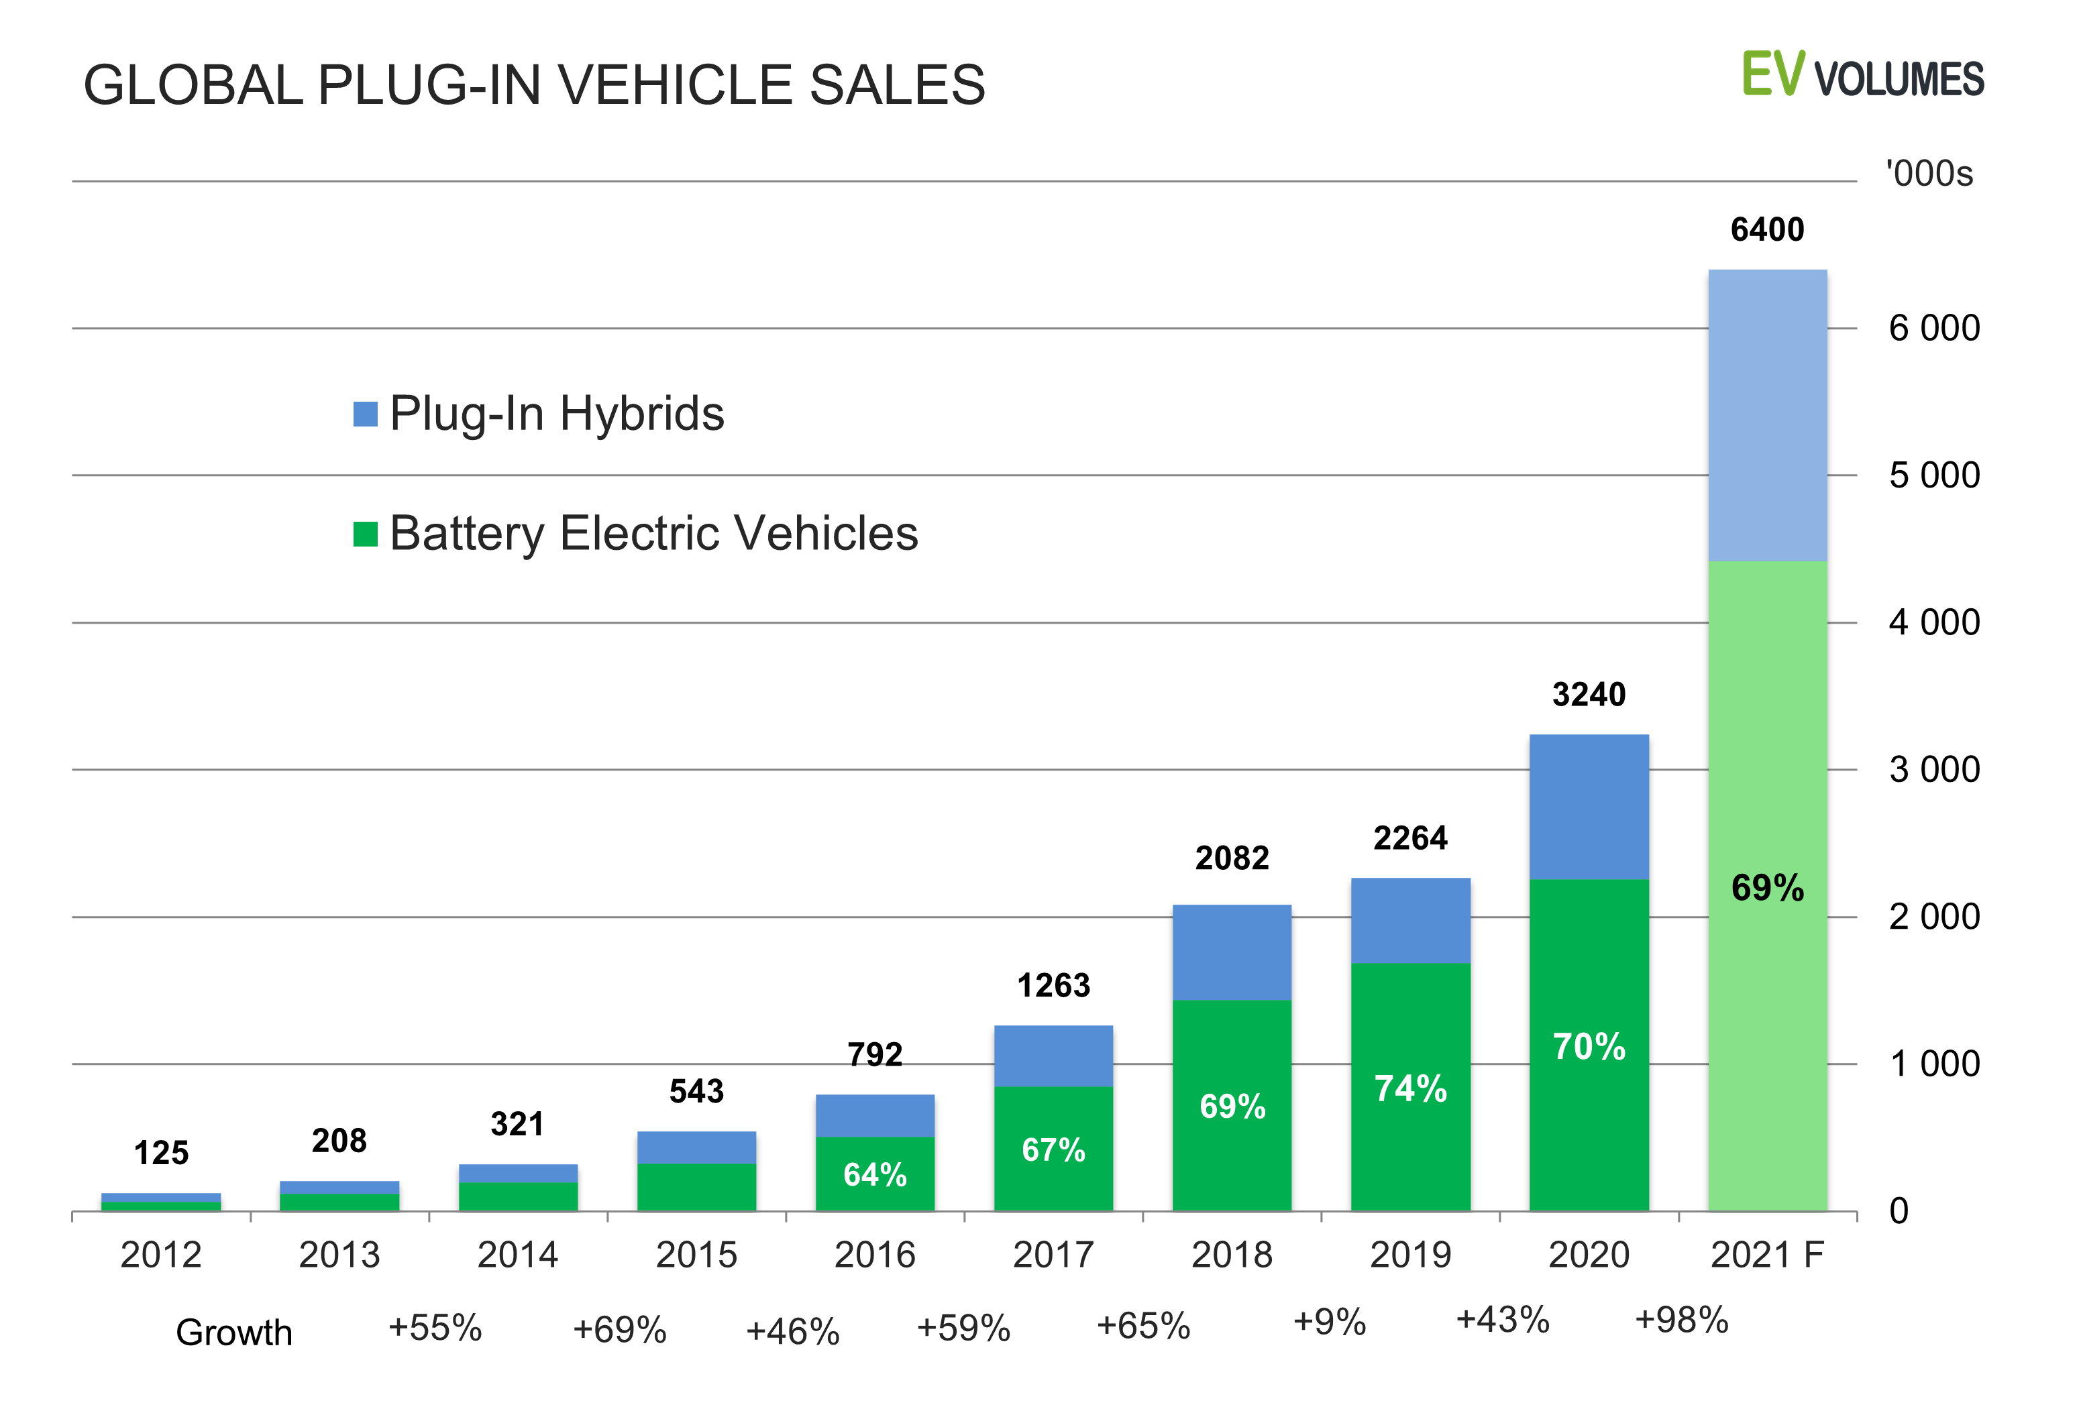
Product Viability
PRODUCT VIABILITY
Market Share Increasing
Fossil Fuel Phase-Out
Growing Field

Slide 8

The future of the product
Texting implementation
Mobile Application
Machine Learning
General Waiting-Time Optimization

Slide 9




Image and market data credits
Reuters.com
Worldwide News
Delesign.com Stock Illustrations
Evvolumes.com
Electric Vehicle reports
Vecteezy.com
Stock Images

